Slide 1

Used Cars
Analysis
Fundamentals of Data Analytics
CSIS 3360 - 001
Professor Nikhil Bhardwaj

Slide 2

Team Members
Gurkanwal Singh (300375339)
Harmanpreet Kaur (300363692)
Lovish Dhanda (300377652)

Slide 3
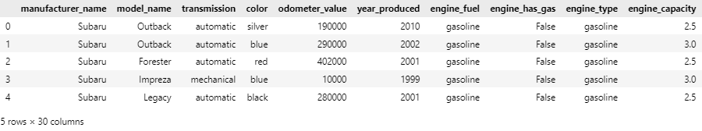
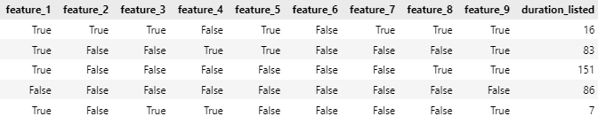
Dataset: Used Cars Catalog (2000-2015)
This dataset contains info. about various used cars for sale, collected from different manufacturers.
Each entry includes various features of the car including manufacturer company & name, engine capacity & type, production year, pricing and details related to the listing.
The data contains 38532 rows and 20 columns.
Dataset URL -
https://www.kaggle.com/datasets/lepchenkov/usedcarscatalog/ data

Slide 4
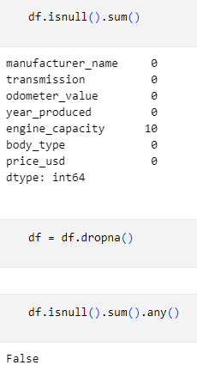
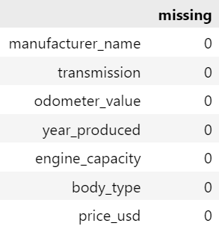
Data Cleaning
Tool used for data cleaning, missing, duplicated and invalid values - python.
Dropped the rows with null values to make data more consistent.
Converted data types. Ex- year_produced to datetime format and reformatted to retain only year.
Left with 38521 rows and 7 columns after data cleaning.

Slide 5
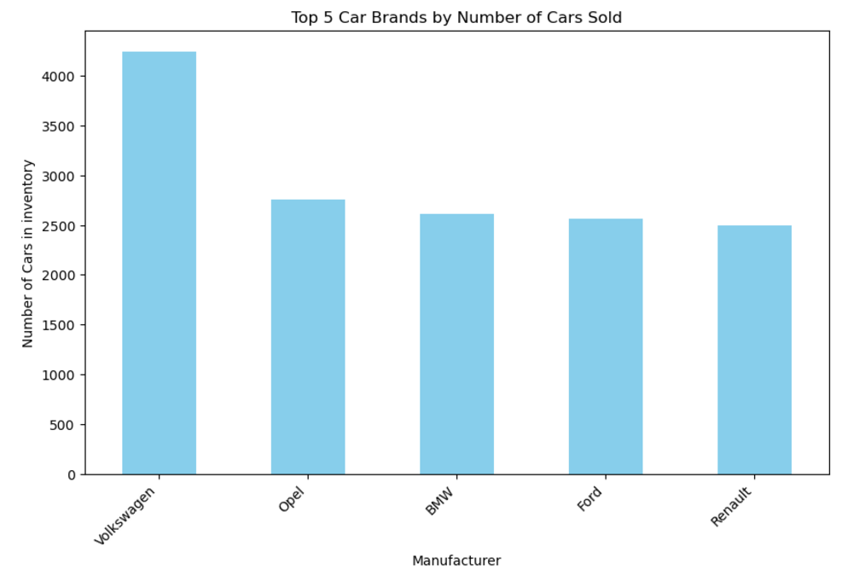
Top 5 Companies in the used car market

Slide 6
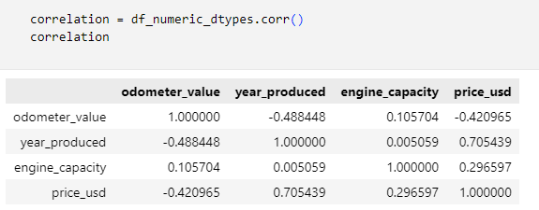
Correlation
Used Python to calculate the correlation between numerical features using the corr() function.
Analysis of the Correlation between Fetures and Car Price(price_usd):
Year Produced: 0.705 (Strong positive correlation)
Engine Capacity: 0.297 (Weak positive correlation)
Odometer Value: -0.421 (Moderate negative correlation)

Slide 7
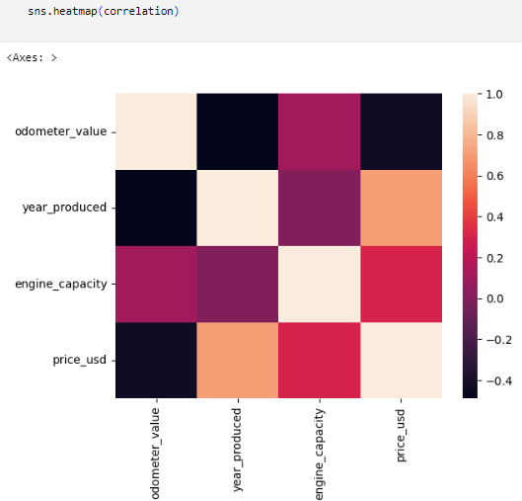
Heatmap showing correlation
This heatmap shows us that with high mortality (+0.8) the relation will be stronger.

Slide 8
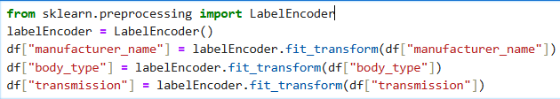
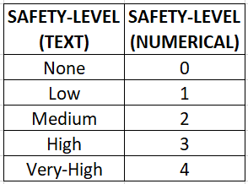
LabelEncoder
Converts categorical labels into numerical form, assigning a unique integer to each category.
Example -
["Acura", "BMW"] → [0, 1]

Slide 9
Models Used
Linear Regression
Random Forest Regressor
k - Nearest Neibors
Naive Bayes

Slide 10
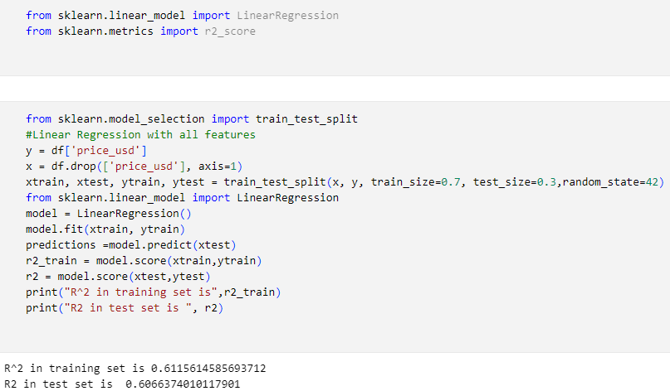
Linear Regression
Models the relationship between a dependent variable and one or more independent variables.
y = g(x), g(x) = αx + β
R-square in the training set is approximately 0.612, indicating about 61.2% of the variance in the training data.
R-square in the test set is approximately 0.607, indicating about 60.6% of the variance in the test data.

Slide 11
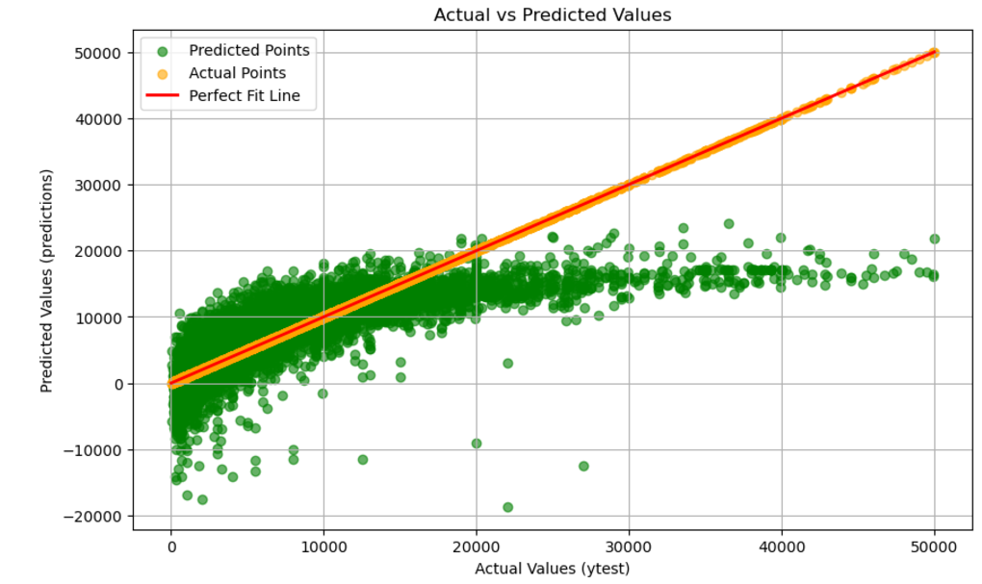
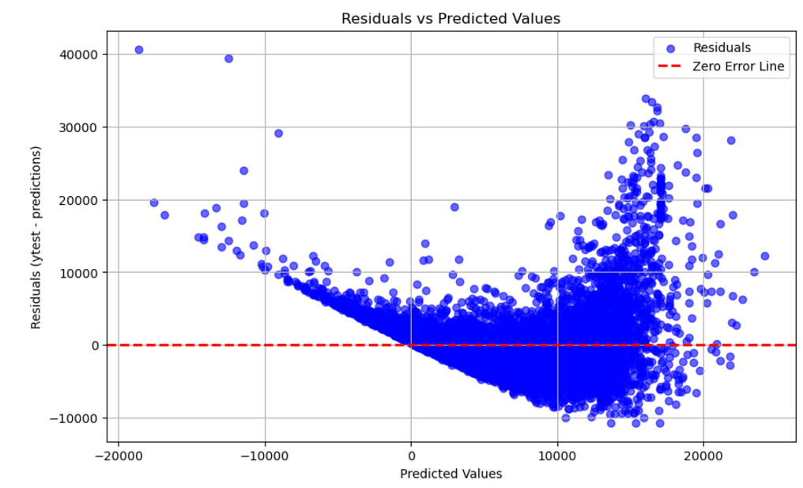
Visualization: Linear Regression

Slide 12
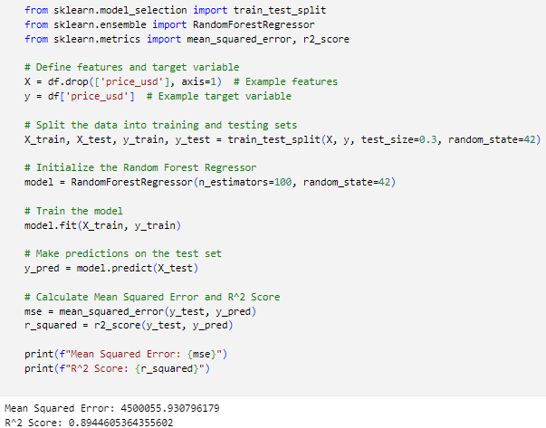
Random Forest
Regression
Ensemble learning method that combines multiple decision trees and random feature selection to improve prediction accuracy
Predict continuous car prices with more complex models
MSE: 4500055.94
R^2 Score: 0.89446

Slide 13
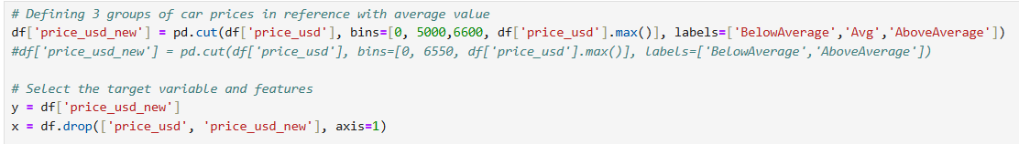
Label Encoder for kNN
Defining 3 groups for price-
Average
BelowAverage
AboveAverage

Slide 14
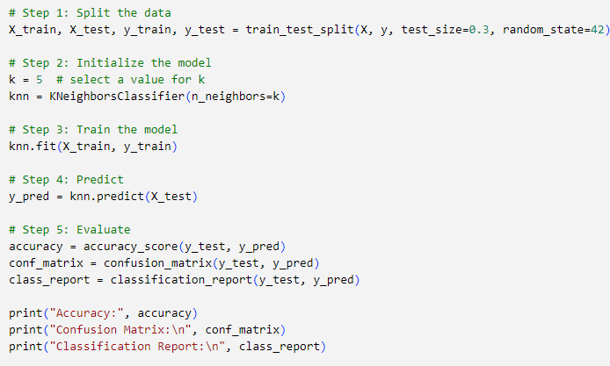
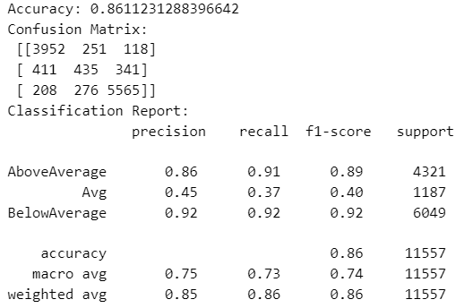
k-Nearest Neighbours Classification (kNN)
Used for classification with car price categories (Below Average, Average, Above Average).
Accuracy score achieved was 0.86, which indicates the model correctly classified 86% of the test instances.
The Confusion Matrix, Classification Report provided more detailed performance metrics, showing the number of true positives, false positives, etc.

Slide 15
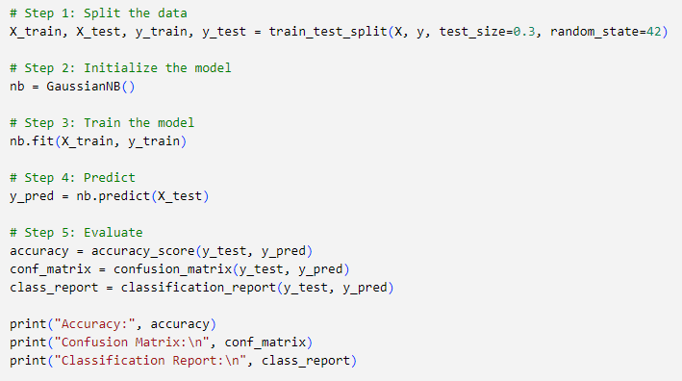
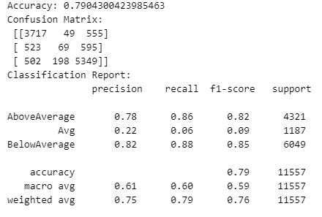
Naive Bayes
Calculates the probability of a data point belonging to a particular class, given the feature values.
The model achieved an accuracy of 79.04%, meaning it correctly classified approximately 79% of the data points into the correct price categories.
The Confusion Matrix, Classification Report provided more detailed performance metrics, showing the number of true positives, false positives, etc.

Slide 16
Compiled Results of All Tests
Random Forest model fits the best in the data set with 0.89 accuracy
k - Nearest Neighbor produced an accuracy of 0.86
Naive Bayes showed 0.79 accuracy
Linear Regression had least accuracy in the dataset with 0.61

Slide 17
Thank You!

